Slide 1
Developing timely statistics in the United Kingdom in response to the COVID-19 outbreak
Louisa Nolan, Chief Data Scientist
1 April, 2021
Notes:
Good morning! Really pleased to be here and great to hear the previous talks
But first. To talk to you about some of what we in ONS, particularly in the data science campus have done, and what we have learned in response to the covid pandemic – exactly 1 yr after the first lockdown

Slide 2
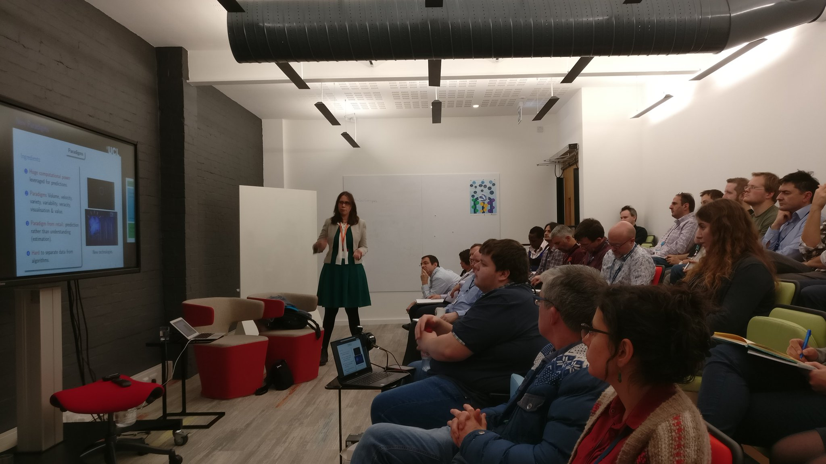
Data
What new data sources were required?
Collaboration
How can we bring people, data and tools together to build capacity?
Data science
Examples from the Campus
Notes:
Want to talk broadly about 3 themes
based on the experience of the Campus in responding to the crisis
Data & collaboration, ingredients for data science
Some examples of data science we’ve produce over the last year
And then round up with a summary of what we’ve learned and some questions for the future which I hope will provoke some questions

Slide 3
Data
Are the restrictions working?
What is the impact on the economy?
Notes:
We start with data – if you don’t have the data, you can’t science it
A year ago exactly…
At the start of the pandemic, there were 2 urgent questions we were asked
Are the restrictions working, particularly around the movement of people, shielding the vulnerable
And what is the impact on the economy
And can we have it daily….
Search was on… data sources that could do this with low latency and high frequency
Building on our faster indicators programme – template for this work

Slide 4
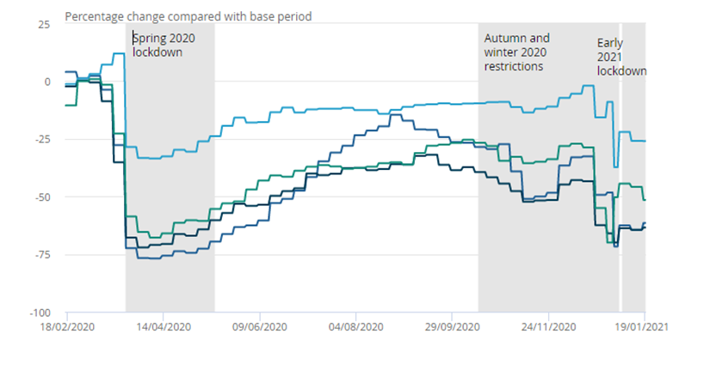
Google Mobility
Converting PDF reports to inform the UK government response to COVID-19 by providing insight into mobility patterns.
Google released Community Mobility Reports for 131 countries as individual PDF reports.
Within 48hrs the Campus published a pipeline to convert the reports from pdf to csv
ONS's geospatial and data visualisation teams produced bespoke geographic tools to analyse and map outputs.
retail and recreation
grocery and pharmacy
transit stations
workplaces
Source: Google Mobility Reports
Coronavirus: how people and businesses have adapted to lockdowns, ONS
Notes:
At the outbreak of the pandemic, as lockdowns were imposed, there was an urgent need to understand the impact of the lockdowns on people’s mobility
Google released data for 131 countries
At national and regional levels
For 6 different types of places: residential, workplace, retail and recreation, parks, transit stations and groceries and pharmacies
Derived from data from those who have turned on Location History
All data are aggregated and anonymised
International comparisons
Bias and uncertainty – useful indicators
BUT – this was initially released as pdf (!)
The Campus team worked flat out to convert the pdfs to machine-readable csv versions within 48 hours, making this available via GitHub to people around the world
Where the Campus goes, Google follows – some time afterwards, Google changed their format to csv
These data, supplemented with data form other sources such as telecoms data, have proved crucial in understanding the impact of lockdown – both the initial all-UK lockdown, and also subsequent recent localised lockdowns
And, we have combined it with card spending data, to analyse the impact of the lockdown and reduced mobility on local economies (Frankie, to note, we can’t show this, but we can mention it..)
This has fed in to the PM’s decision-making

Slide 5
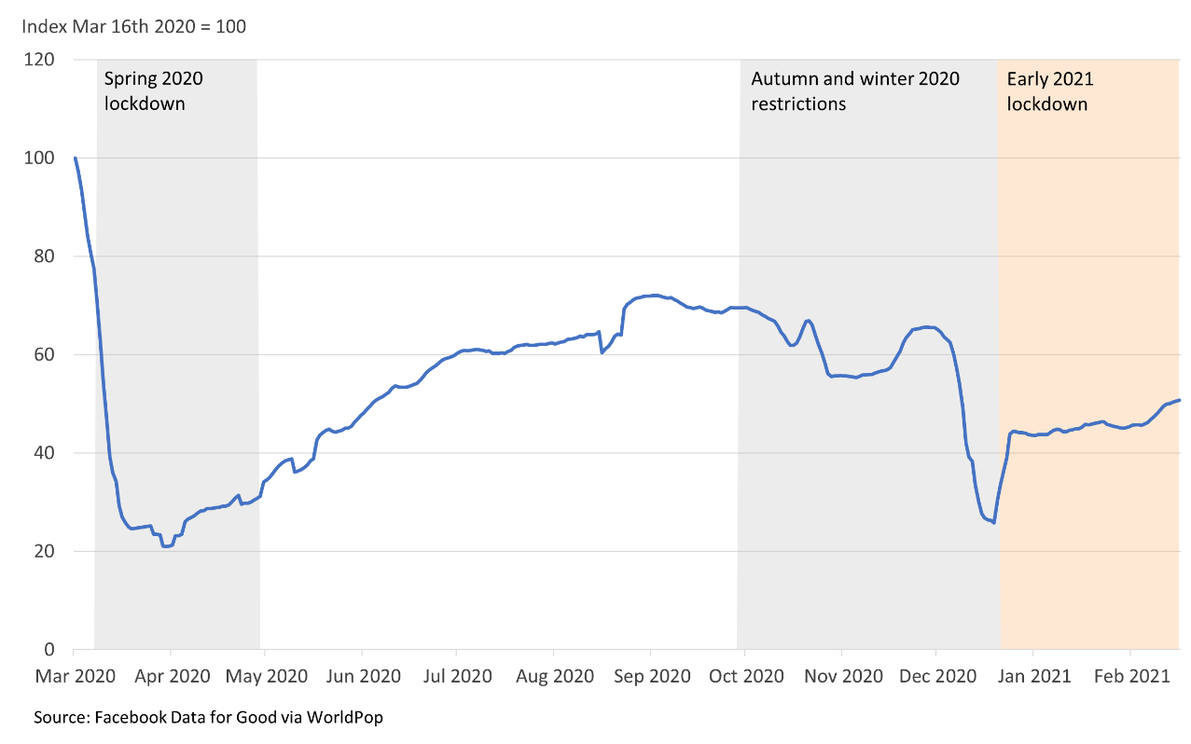
Facebook mobility relative number of journeys between local authorities, UK
Facebook and telecoms data
aggregated and anonymised
changes in mobility trends as lockdown restrictions have been introduced and eased
vulnerable groups, e.g. over 65s
impact of restrictions on commuting
how far people are travelling
how long they spend outside their local area
Source: Facebook Data for Good via Worldpop
Coronavirus: how people and businesses have adapted to lockdowns, ONS
Notes:
Note all data aggregated and anonymised before it reaches us
Rich source of info
Highlighted uses of this sort of data for post-covid work, including around mobility and real-time populations
Aggregated - trust
But this doesn’t tell you about more detailed behaviours, and represents trends, each with own biases
Compliance with lockdown, self isolation, bubbles?
Wearing a facemask? – ethical implications of monitoring this, as well as technical ones – no training dataset
Still need to ask directly – opinions and lifestyle survey
And of course infections need to be tested, ONS also stood up vast Covid infection Survey very rapidly. Giving robust results for population rate of infection
But very clear that these data hold lots of promise – real time pops, migration, travel, tourism and so on – continue to explore post covid, x-gov, DA, local gov

Slide 6
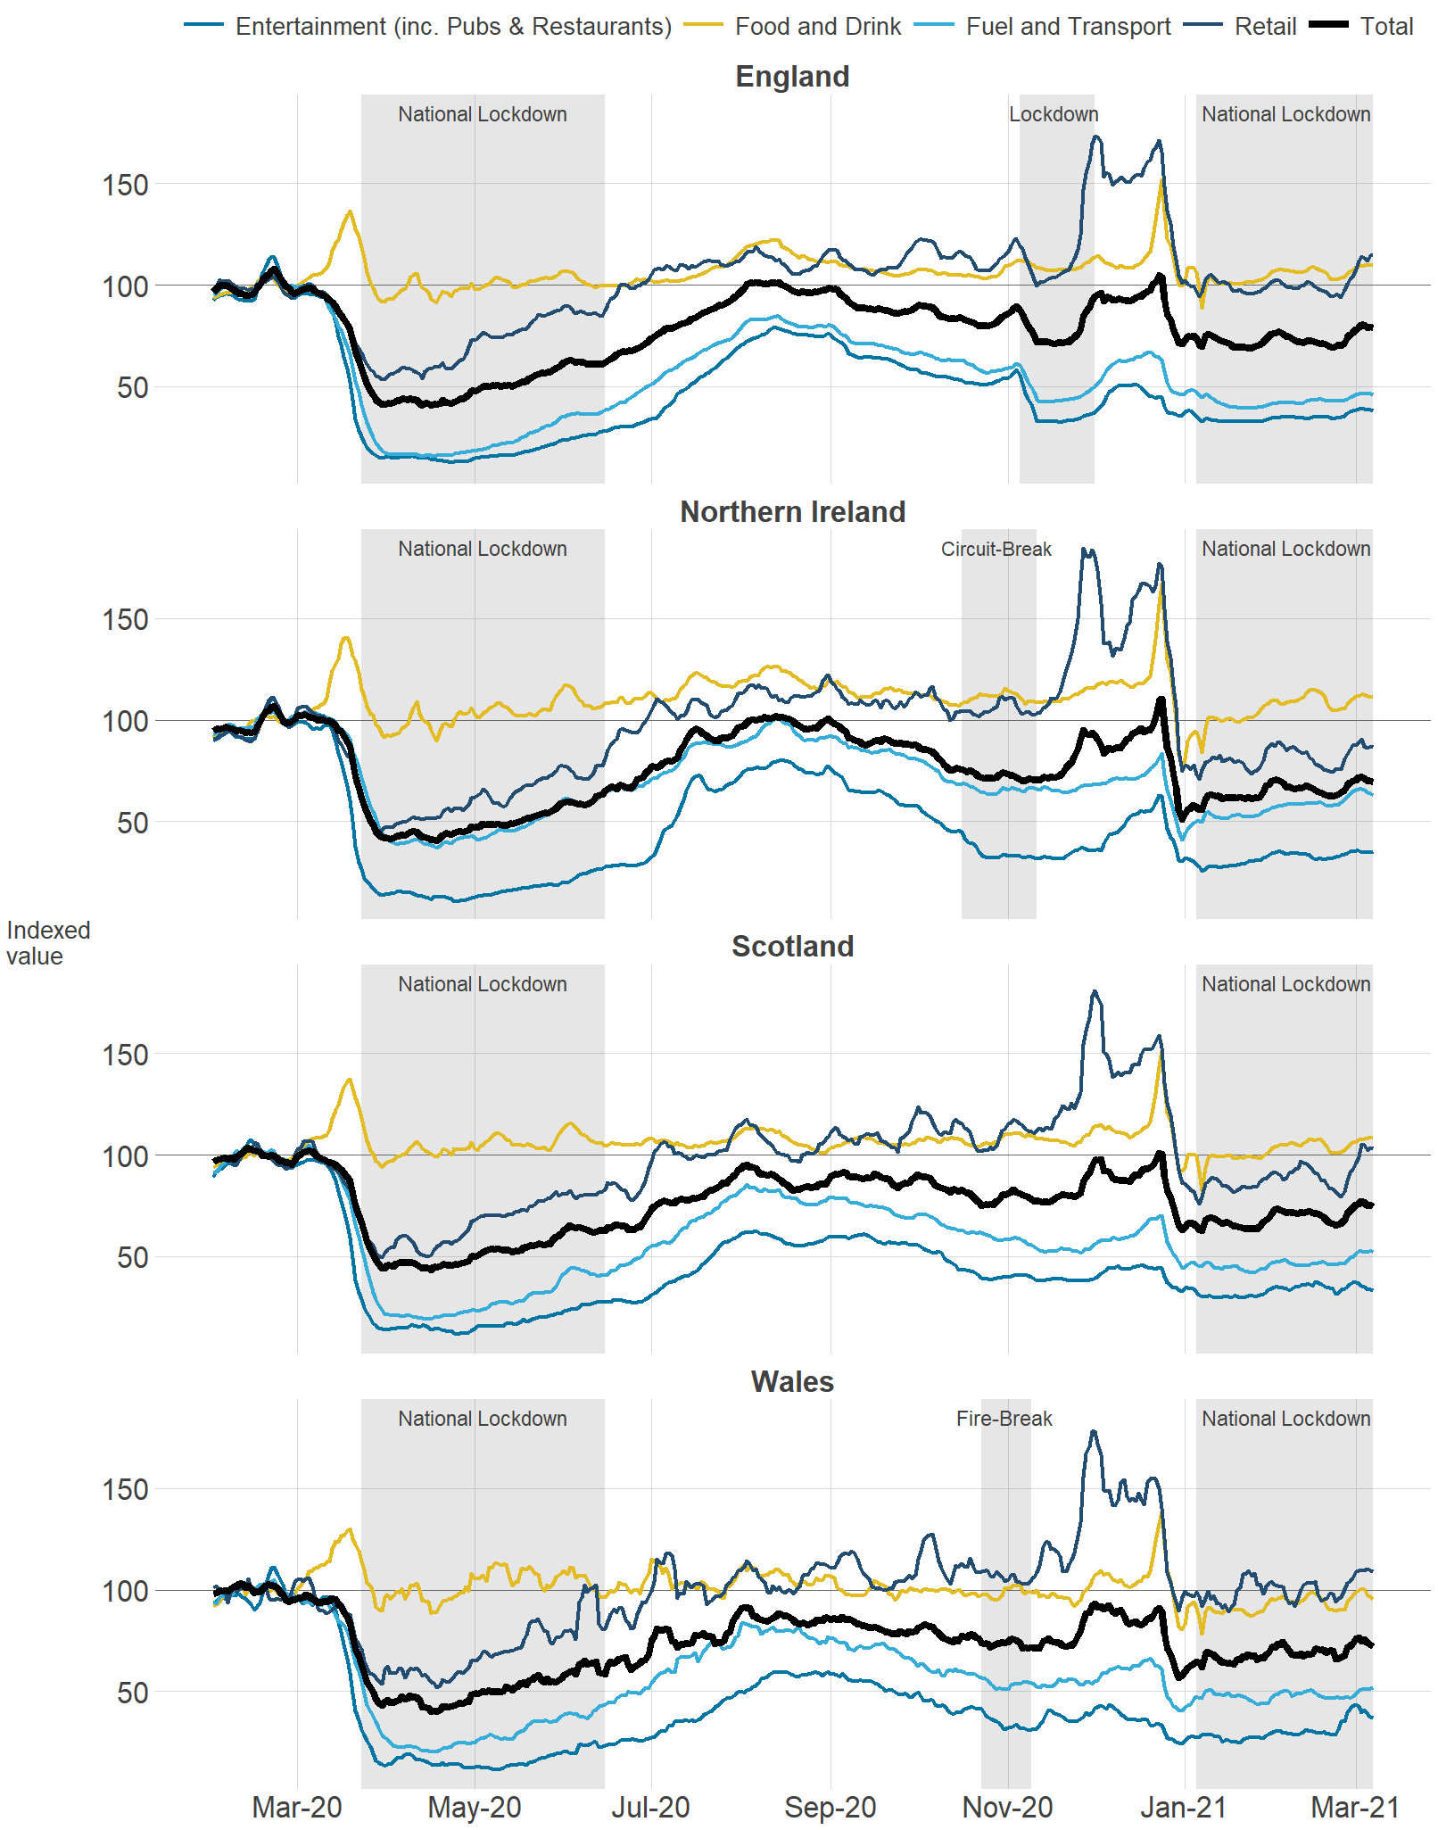
Consumer spending
entertainment, incl pubs and restaurants
food and drink
fuel and transport
retail
total
Pre-March 2020 lockdown spike
Increased resilience
Need to co consider
bias in customer base
classification differences
cardholder address, not merchant location
Source: Revolut, Office for National Statistics calculations
Coronavirus: how people and businesses have adapted to lockdowns, ONS
Notes:
spending data vital to understand impact
Important to be granular, especially as different restrictions came in
Fascinating chart from recent publication
But data isn’t a survey, so we know there are biases in the population – rapid assessment of quality versus decades of understanding surveys
Clear that fast indications of trends are useful to decision-makers in rapidly-changing situations

Slide 7
Collaboration
Who do we need to work with? Data, skills, knowledge
How do we build a network for review and challenge?
How can we collaborate securely?
Notes:
Additional skills
Focus on priorities
Leverage opportunities
Have already talked about some of our private sector relationships, also call on academic sector, particularly for independent QA of models – particularly for a rapid response
Data acquisition and data engineering
And of course colleagues across government
But, to collaborate, you need the right tools and environments as well

Slide 8
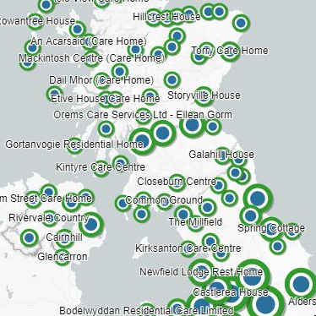
Geospatial Role in Covid response
LOCATION &
DATA SOURCES
Sample sites
Cases
Location of risk
Sample frames for surveys – Covid infection survey, wastewater
Statistical base and denominators for analysis
Collaboration with the Joint Biosecurity Centre
High risk industries
Wastewater monitoring
Data for risk modelling
DENOMINATORS
Lockdown Population
Age
Ethnicity
etc
BOUNDARIES Statistical and
operational for
analysis
& visualisation
Notes:
Data & people – geospatial - underpins iother work – you need ot have good denominators
granular geospatial data important
Need good denominators
+ also working closely with jBC – focus on priorities
Wastewater – Turns out, covid can be detected in fecal matter. Opportunity to identify outbreaks in waste water
Mapping high risk industries
Feeds into risk model for covid

Slide 9
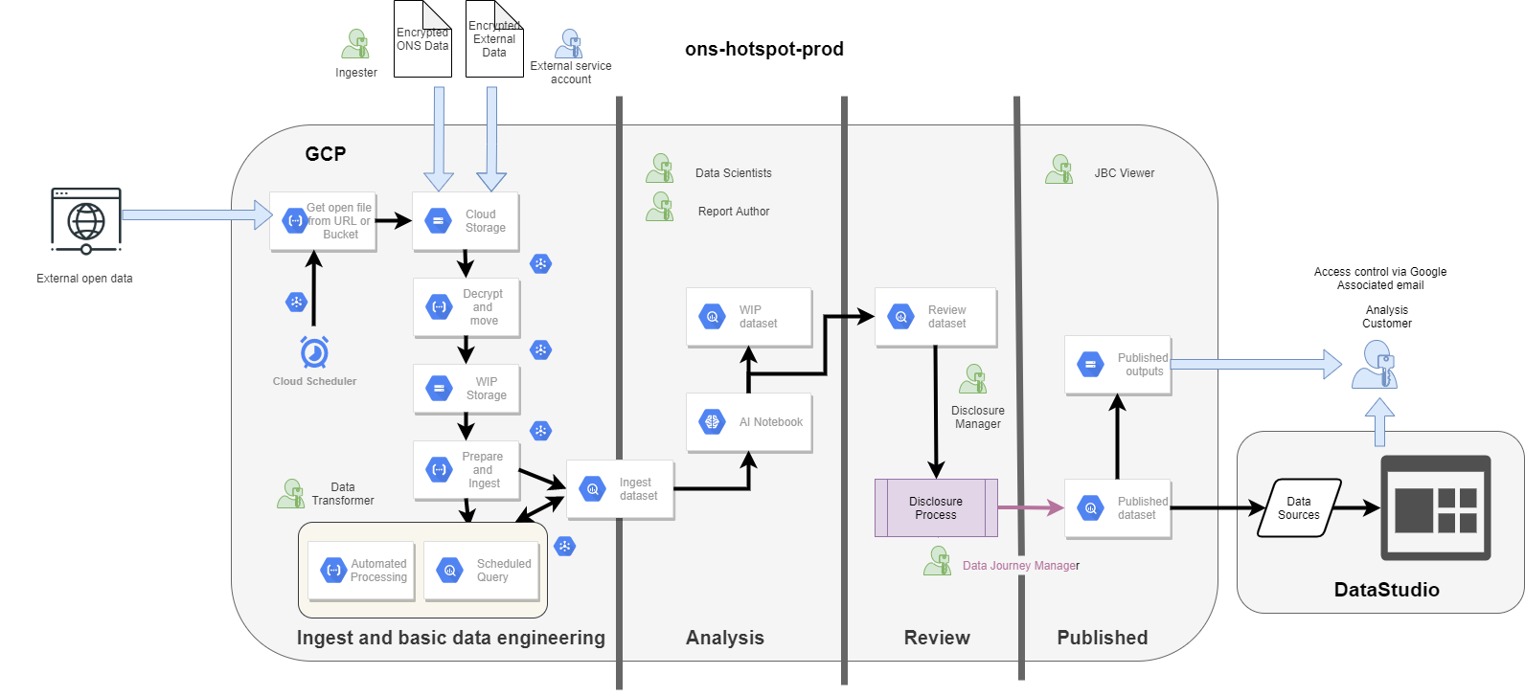
Secure collaborative cloud platform
Security first design
Flexible analytical platform with cloud native scaling
Roles-based permissions
Access for approved analysts to shared outputs
Infrastructure as code – reusable template
Notes:
To collaborate, need a secure platform – data + right tools + people + processes
Google cloud
For collaboration with joint biosecurity centre – different data sharing permissions for different datasets – both disclosure control and commercial considerations
Security at heart of the design, zero trust with different
Cross department design and implementation delivered at pace
Data ingested and stored in BigQuery data warehouse
Hosts both prototyping and automated analysis
Disclosure controlled area for sharing outputs
Over 30 users, 73 datasets, 15 external users on DataStudio and costs ~£300/month
Template for other work – to date, 2 others, feeding into IDP

Slide 10
Data science
How can we get more information faster?
How does this help us to monitor and interpret the situation?
Notes:
3 examples – text and images to produce timeseries and insights
Focussed on those early questions
As time progresses, move away from rapid response to more complex analysis, but immediate needs are for rapid info

Slide 11
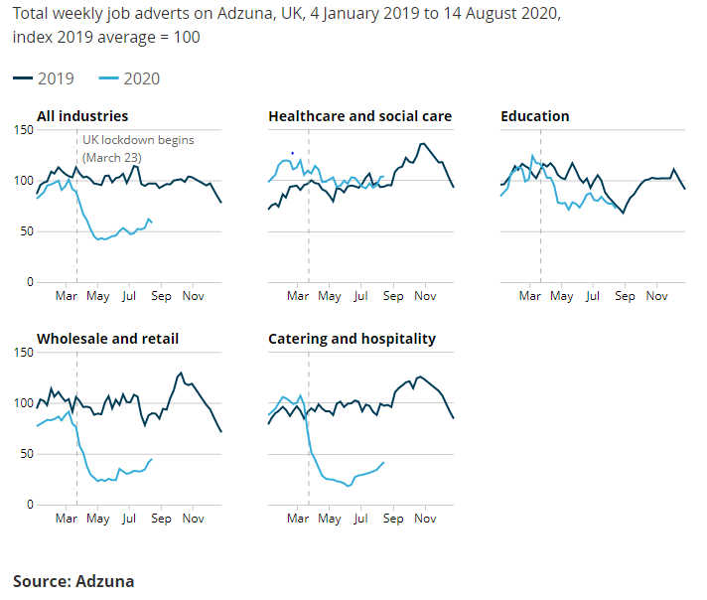
Using Adzuna data to derive an indicator of weekly vacancies
Adzuna is a comprehensive online job search engine that collates information from thousands of different sources in the UK.
> 100 million job adverts in the time series to date from February 2018.
Broken down by job category and by region, based on the information included in the job advert.
Adzuna’s neural network assigns suitable categories to the job adverts based on each advert’s text.
Vertical dashed line = start of lockdown
Faster indicators publication
Notes:
•The impact of lockdown on UK businesses and employment has been rather dramatic
•Using data from online job adverts, we have created a rapid, high-frequency indicator of job vacancies in the UK
•This is one of several administrative datasets being explored to provide faster indicators of economic activity in the UK (REF IF NEEDED; there’s also VAT data and road traffic data, and AIS/ship tracking data is in development)
Part of suite of faster indicators
•Adzuna collects millions of online job adverts, allowing us to create a breakdown of adverts by region and by the 29 categories like “Healthcare / nursing” and “IT / computing / software” that Adzuna assigns.
•The data source is extremely timely compared to surveys - we’re able to publish this data within 6 days of extraction of the data from Adzuna’s systems, and publish weekly.
•The information is used to proxy job vacancies, presented as an index against the 2019 average (== 100).
•You can see the dramatic change with lockdown in the light blue 2020 index, with lockdown marked by the vertical line.
•Online adverts can only be a proxy for vacancies, the data is limited in that adverts do not necessarily correspond to the number of vacancies, and different business types will use online adverts to lesser and greater extents, hence the choice of relative indicies for communicating the series.
•Future work will include mapping the adverts to SIC and SOC classifications, and extracting information on key skills being asked for in different categories and how those change in time.
Geographical breakdowns

Slide 12
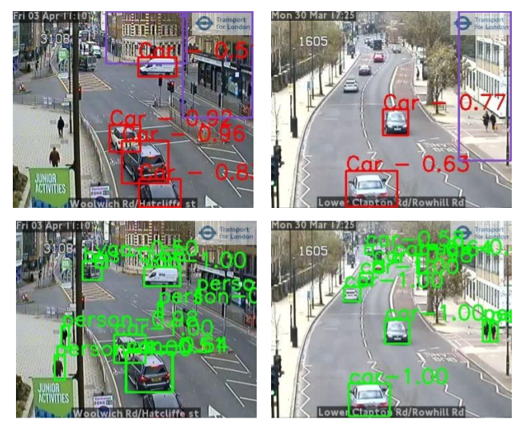
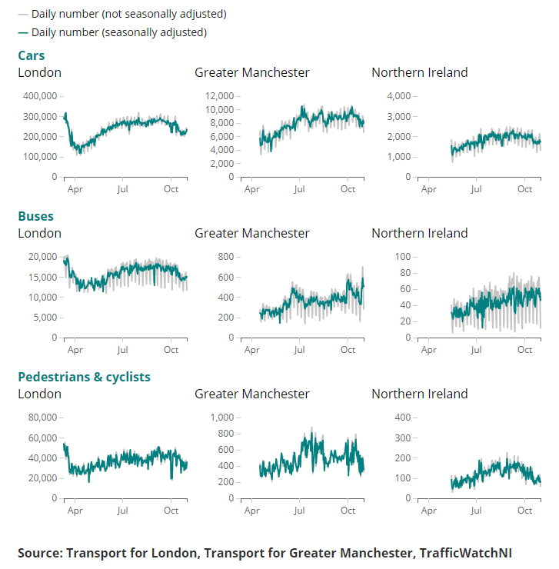
JamCams
Using publicly available streamed traffic camera images to monitor busyness during lockdown
Regular publication in ONS coronavirus faster indicators
European Statistical System collaboration
Collaboration with Newcastle University
Notes:
Pipeline to bring in real-time data
Convolutional neural networks – identify types of vehicle
Can’t identify individuals – can identify if they are a person, but not6 who
Create time series
Regular publication in FI
But, what we didn’t do: are people observing social distancing of 2 metres? Hard to do, technically, largely town centre cameras, is this representative?

Slide 13
Analysing COVID-19 notices from business websites
Using data extracted from business websites to inform business survey decision making and response chasing efforts.
Text extracted from 500,000 business websites by private sector partner glass.ai, subsequently linked to the Inter-Departmental Business Register.
COVID-19 notices identified by keywords (e.g. "coronavirus", "government advice", "social distancing").
An analysis of the proportion of businesses using their websites for COVID-19 communications was carried out by sector and size band.
Natural language processing techniques were used to classify snippets according to the response of the business.
https://almeida.co.uk/ © Almeida Theatre, London N1 1TA Registered Charity No. 282167
https://www.madametussauds.com/london/ © Merlin Entertainment Group 2018, all rights reserved. © & TM Lucasfilm Ltd.
Notes:
Briefing Note:
“No part of the economy remains untouched by the impact of the virus” – Jonathan Athow (blog)
By May the Business Impact of COVID-19 Survey (BICS) had shown us that around one in four businesses had temporarily stopped trading.
It was recognised that this could provide challenges to the production of economic statistics, particularly in terms of potential bias introduced to survey estimates by non-responding businesses.
The widest possible sources of data were brought together to understand the performance of businesses.
This included working with private sector partner glass.ai to read the covid notices on home pages of more than half a million business websites to better understand their trading status.
Record level data from business websites was combined with other data sources and made available to the response chasing efforts in Business Data Operations Division (BDOD).
Challenging problem, but one we needed to explore – used key words & linked to IDBR - ~0.5 million businesses in the sample, but fewer with notices & linked
collab with private sector again
Didn’t resolve the problem, had ot explore, identified some further ideas to follow up & demonstrated what could be done
Reference: Some of the above note (including “around one in four businesses had temporarily stopped trading”) is from Jonathan Athow’s May 29th 2020 blog: https://blog.ons.gov.uk/2020/05/29/no-part-of-the-economy-remains-untouched-update-on-how-the-ons-is-measuring-the-impact-of-covid-19/

Slide 14
What have we learned?
I am very proud of all my ONS colleagues
Appetite for faster information – timeliness versus accuracy
Collaboration is important – across academic, private and public sectors and across disciplines
Need access to right tools, skills and environments
Novel data sources can give new insights – not only for Covid
Quality, caveats, communication to non-analysts
Notes:
That was a very small selection of some of the work done by ONS – there has a been a huge amount more done, and I wanted to say first, how proud I am of the response from all my ONS colleagues
Haven’t talked about the covid infection survey, or the business impact of covid-19 survey, or the opinions and lifestyle survey or many of the other amazing things…
But, here’s some of the things we’ve learned
Collaboration – needs to feed rapidly into decision-makers, data + skills + subject matter experts
Novel data sources – commercial confidentiality – rich source of big data in private sector
Caveats and quality issues as lots of new models and data sources are stood up – need to be careful about presentation to non-analysts
Innovation
And some thoughts about preparing for the future– don’t be afraid it won’t work

Slide 15
How can we prepare for the future?
Explore new data sources
Learn from each other
Data fusion – big data + statistical data
Complex relationships – simulations, digital twins, more ML / deep learning
More value from synthetic data & federated approaches
Crises require rapid response, complex models take longer to develop
Innovate…
Notes:
Collaboration – needs to feed rapidly into decision-makers
Caveats and quality issues as lots of new models and data sources are stood up – need to be careful about presentation to non-analysts
Innovation
And some thoughts about preparing for the future– don’t be afraid it won’t work

Slide 16
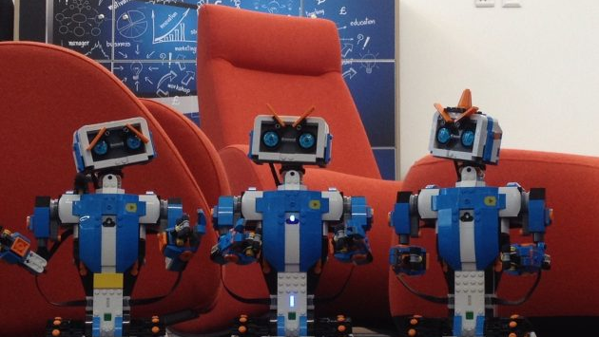
Contact us
datasciencecampus.ons.gov.uk
@DataSciCampus
datasciencecampus@ons.gov.uk
datasciencecampus

